Slide 1
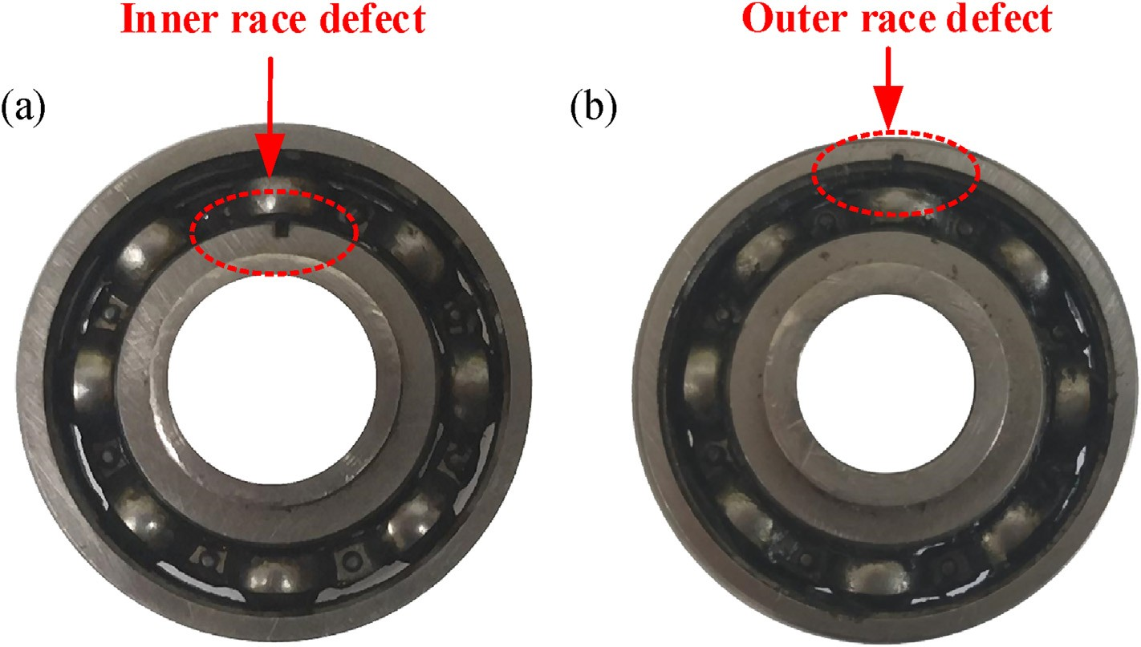
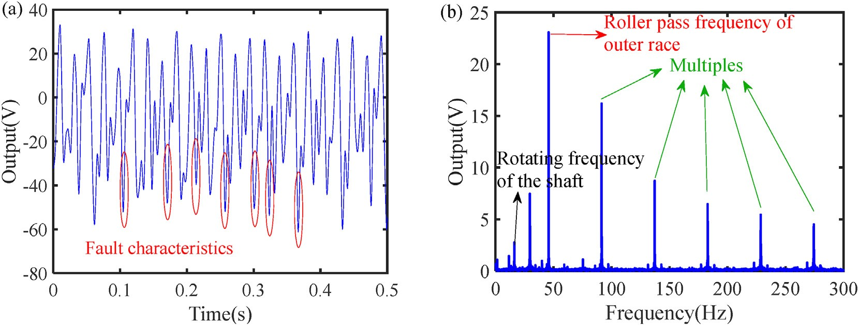
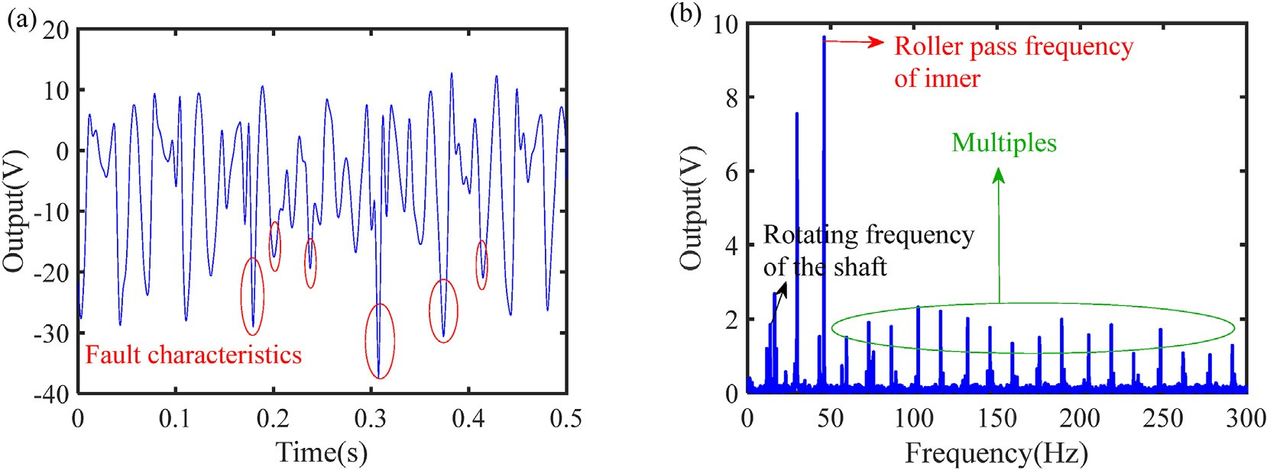
L. Zhang, F. Zhang, Z. Qin et al.
Energy 238 (2022) 121770
Fig. 13. Defective rolling bearings with (a) Inner race defect, and (b) Outer race defect.
Fig. 14. Output voltage with rolling bearing involving outer race defect: (a) time domain, (b)frequency domain.
Fig. 15. Output voltage with rolling bearing involving inner race defect: (a) time domain, (b)frequency domain.
applications in remote condition monitoring of rotating machinery. element bearings. In the energy harvester, an arc-shaped piezo-
electric sheet was cut into conductive sections and installed be- tween rolling bearings and lower part of pedestal. An
5. Conclusions
electromechanical coupling model was proposed to demonstrate the working principle of the proposed energy harvester. A series of
This paper proposed a piezoelectric energy harvester capable of experiments were then conducted to explore the output harvesting electrical energy from rotating machines via rolling
9

Slide 2
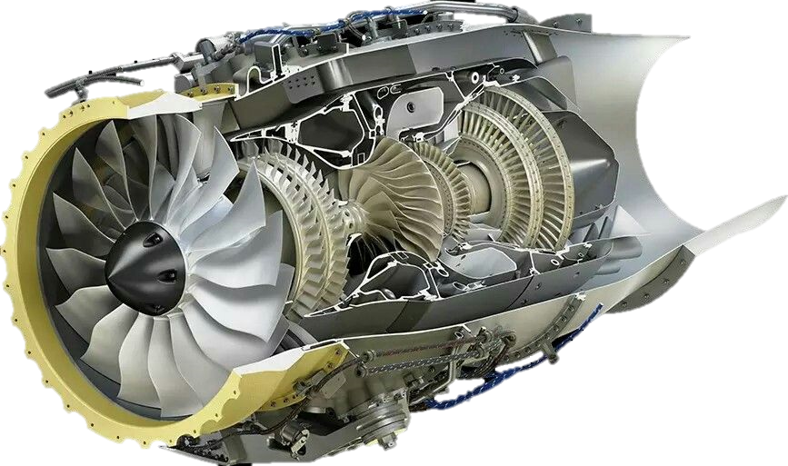

Slide 3
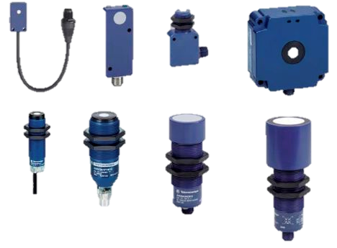
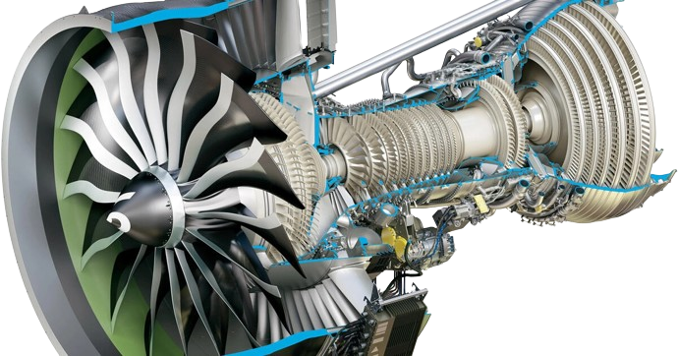

Slide 4


